Slide 1
Winter Academy: WAR OF THE WORLDS
PUBLIC HEALTH & EPIDEMIOLOGY
11th & 12th Grade
Ms. Kelly Gallagher
Rm B542

Slide 2
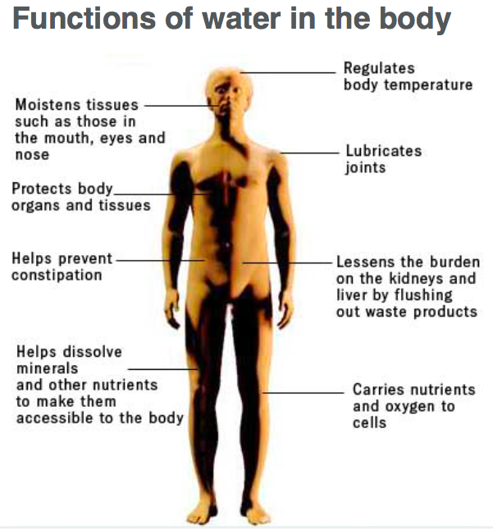

Slide 3
Water Changes Everything

Slide 4
The Story of Cholera

Slide 5
Diarrheal Disease
Second leading cause of death in children under 5 (760,000/year)
A significant proportion of diarrheal disease can be prevented through safe drinking water and adequate sanitation and hygiene
Globally, there are nearly 1.7 billion cases of diarrheal diseases every year
Leading cause of malnutrition in children under 5

Slide 6
Causes
Infection: bacterial, viral & parasitic; spread by feces-contaminated water
Malnutrition: children suffering from malnutrition are more vulnerable to diarrhea
Source: water contaminated from sewage, septic tanks, latrines & animal feces
Other: person-to-person, contaminated food

Slide 7
Treatment
Rehydration: ORS, only a few cents per treatment
Zinc supplements: reduce duration; stool volume
Rehydration: IV fluids in case of severe dehydration or shock
Nutrient-rich foods: exclusively breast milk for babies (under 6 mo)

Slide 8
Final Presentations
Time to begin preparing for final presentation 10:50am – 11:40am
Finalize teams / Select topic
What is public health?
Public Health Agencies & careers
Pick a virus: HIV, Zika, Yellow Fever, Malaria, etc
Chronic diseases
History of Public Health & Epidemics
Methods of Transmission
Violence / suicide
Environment / Natural Disasters: clean drinking water
Future of Public Health: Technology? Epidemics?

Slide 10
2013 Haiti

Slide 11
Dr. Dilip Mahalanabis
“potentially the most important medial advance of the 20th century”
In the mid-sixties WHO doctors developed Oral Rehydration Salts for treating Chloera in adults at their research facility
When faced with a cholera epidemic in 1971 Dr. Mahalanabis realized there was not enough IV and a limited number of trained team members to give fluids.
He had no choice but to allow non-specialists to administer ORS (against prevailing wisdom at the time).

